Slide 1
Building an VR ship game
VCS2 Own proposal Hugo Leenen

Slide 2
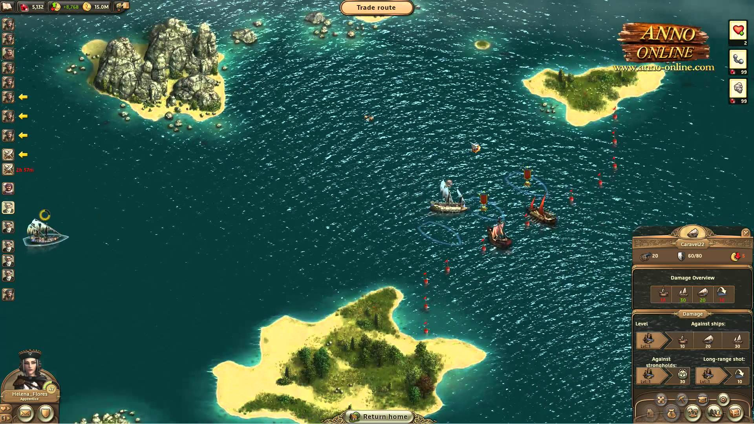
Goals
Display visual information
Replace traditional input devices
Create a fun to watch simulation

Slide 3
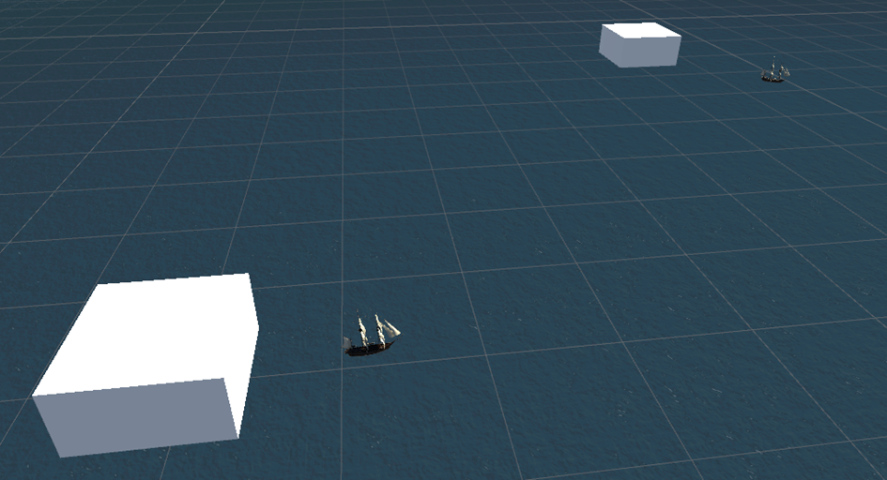
Process
Started on a basic system were boats go from one island to the next.
Navigation in the environment using the Vive controllers.
Displaying UI elements in VR.
Interaction with UI elements.

Slide 4
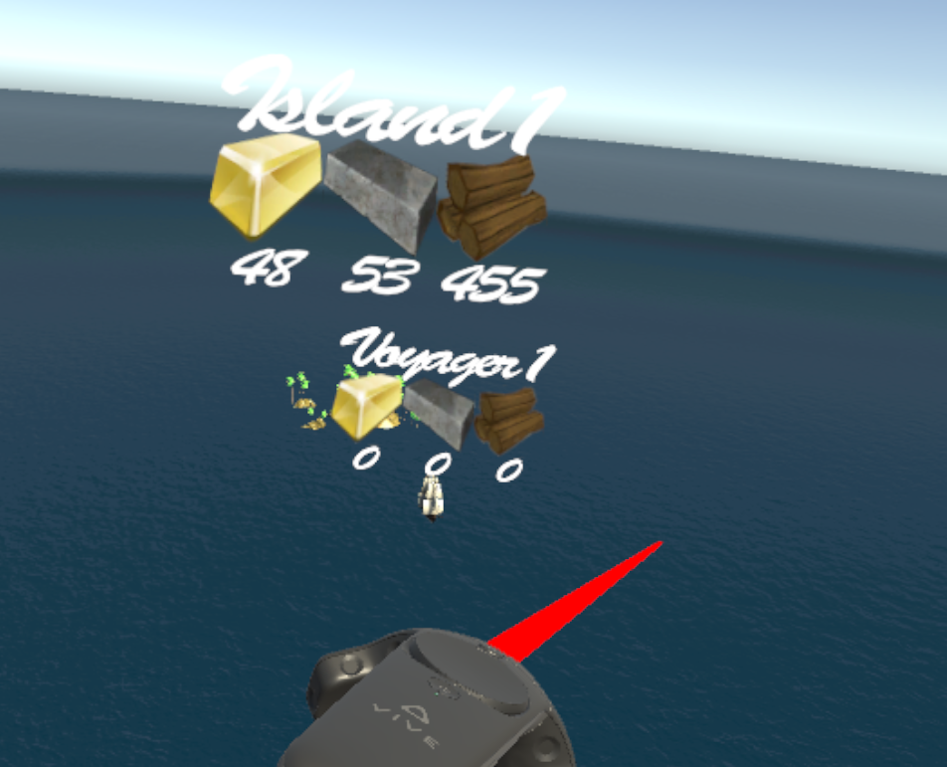
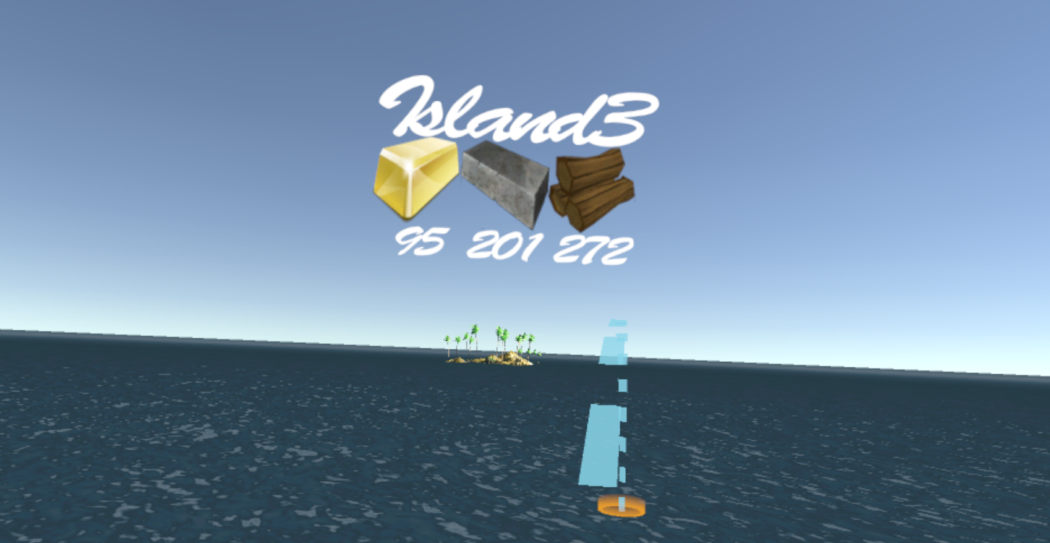
Conclusion
Learned a lot about the Vive controllers (and the restrictions you dont have).
Learned a lot about designing a Vr application were the user is able to do more than pick up objects and navigate around the environment.

Slide 5
Questions?

